Slide 1
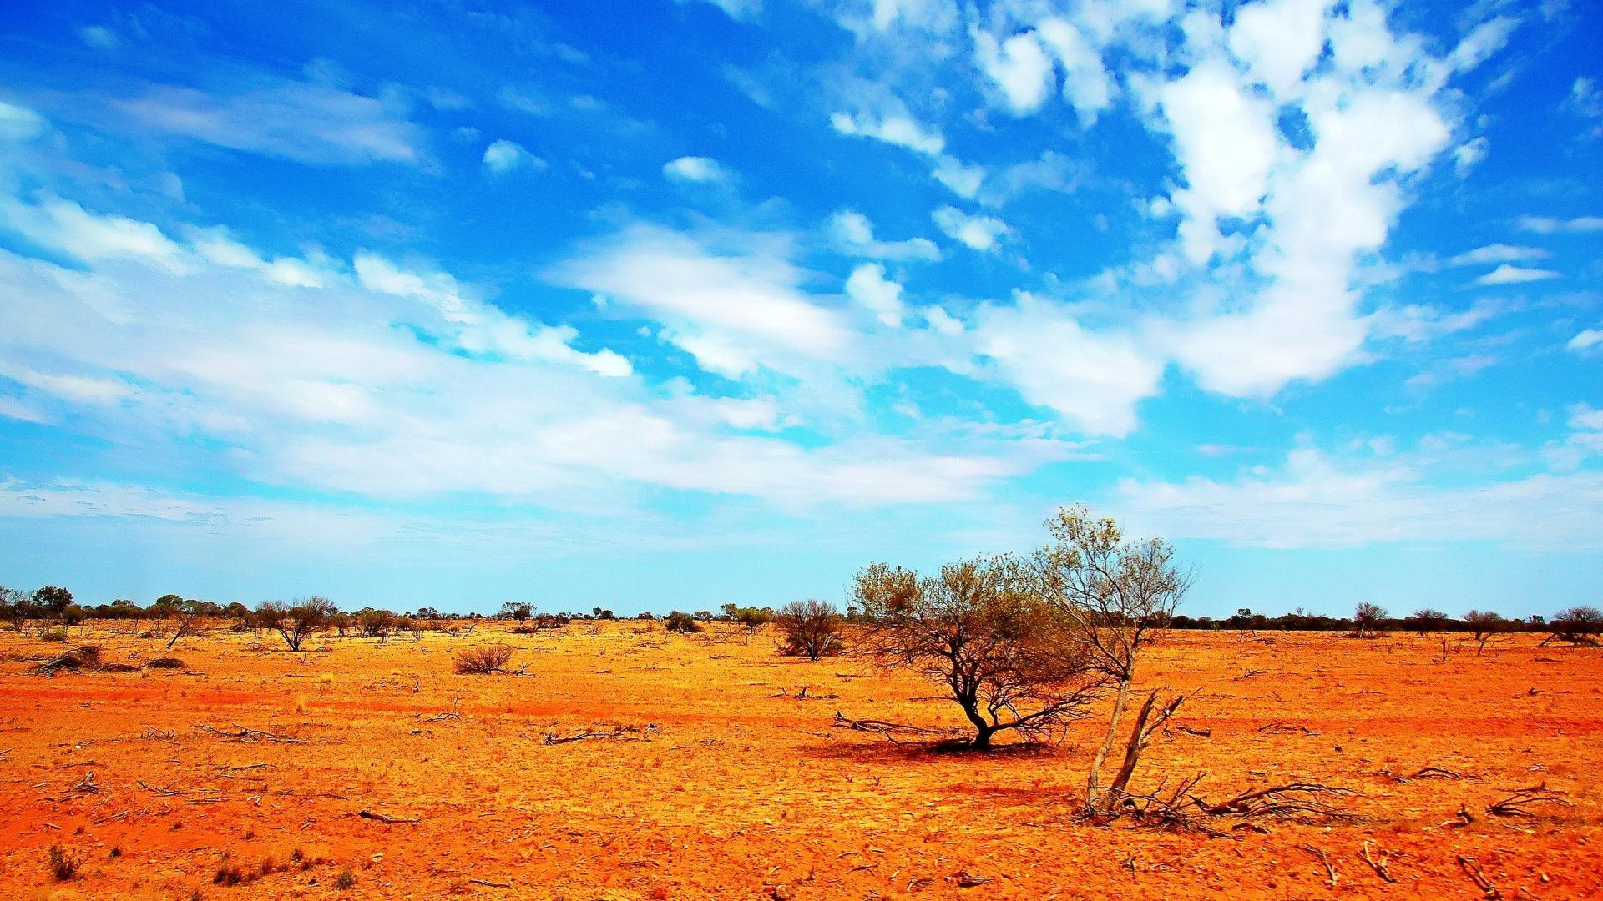
Welcome!

Slide 2
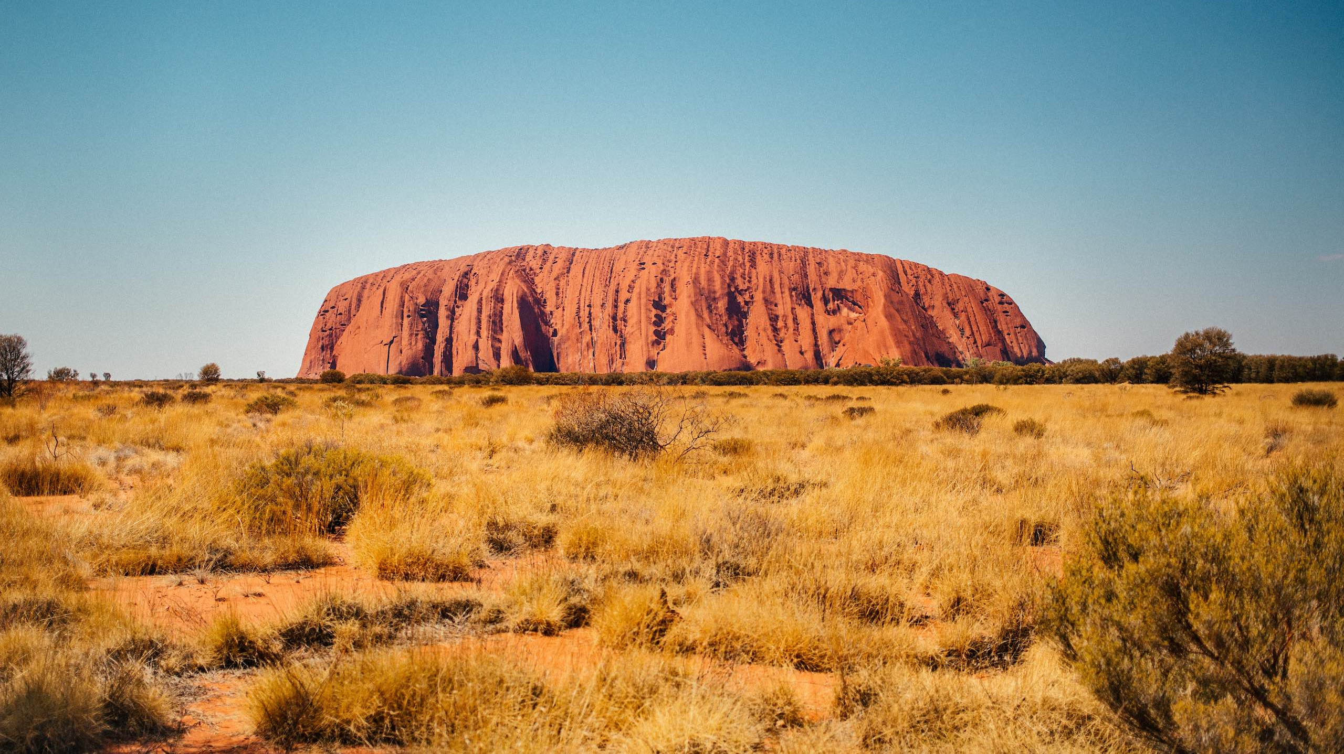
Digital Divide for Indigenous Australians

Slide 3
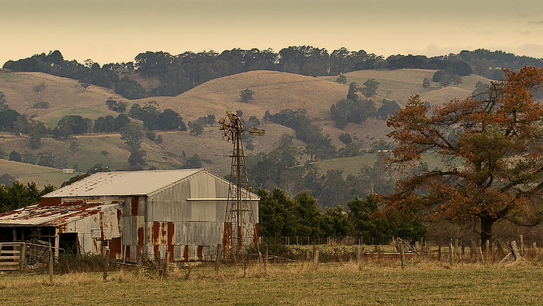
What is the Digital Divide?
Difference between those that have access (to ICTs) and those who don’t
Why is this important?
First, we must understand what causes the divide

Slide 4
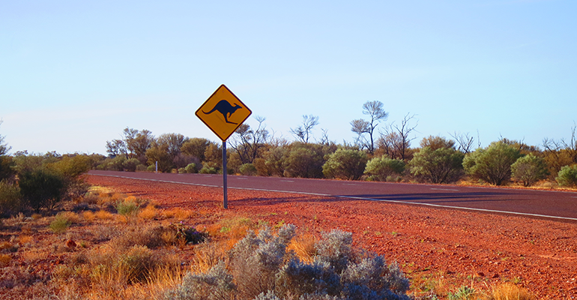
Causes of the Divide
Income
Lack of personal value towards ICTs
Poor user skills
Infrastructure
Location
Lower Quality connections

Slide 5
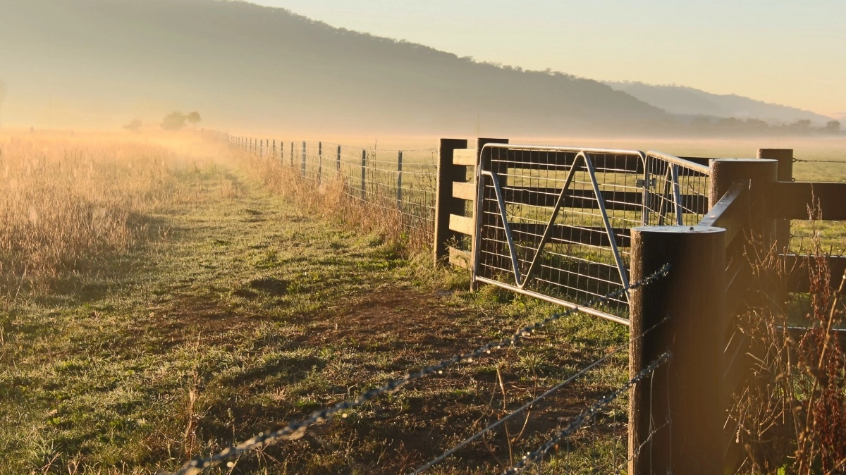
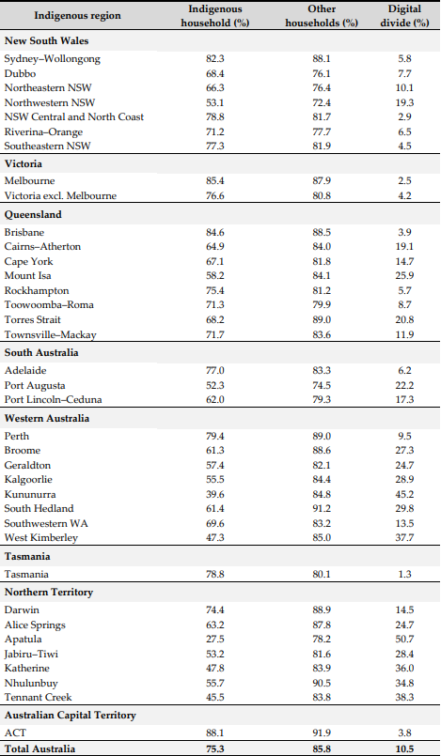
Who is affected by it?
Rural/Remote Areas, largely affected
Inner/Outer regional, largely affected
Urban Areas
Generally, Communities everywhere
As seen in Table 2

Slide 6

Negative effects
Lack of access to health services
Less access to education
Less to no connection to more communities nationwide/internationally
May be unable to share traditions/information with larger audiences

Slide 7
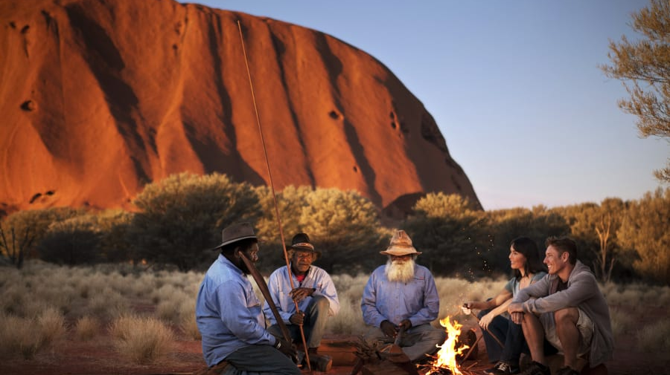
How to close the gap?
Offer education
Improve infrastructure
More affordable pricing

Slide 8
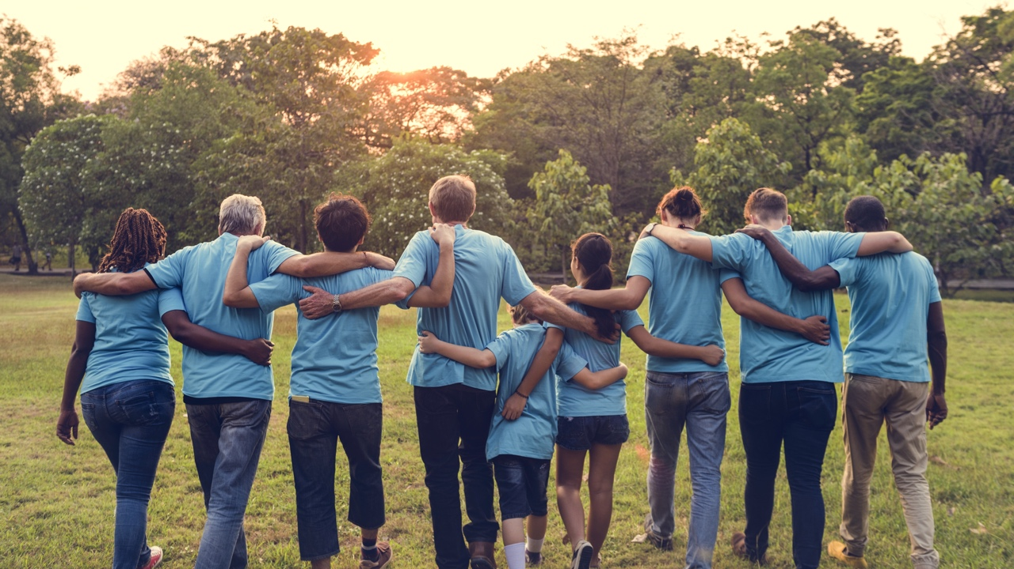
Benefits of closing the gap
Access to more health services
Closing distance through online services
Creating more social opportunities
Allowing participation in the digital economy
Access to more training and learning
Promoting travel and tourism

Slide 9
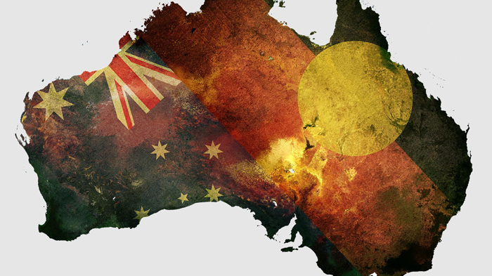
Conclusion

Slide 10
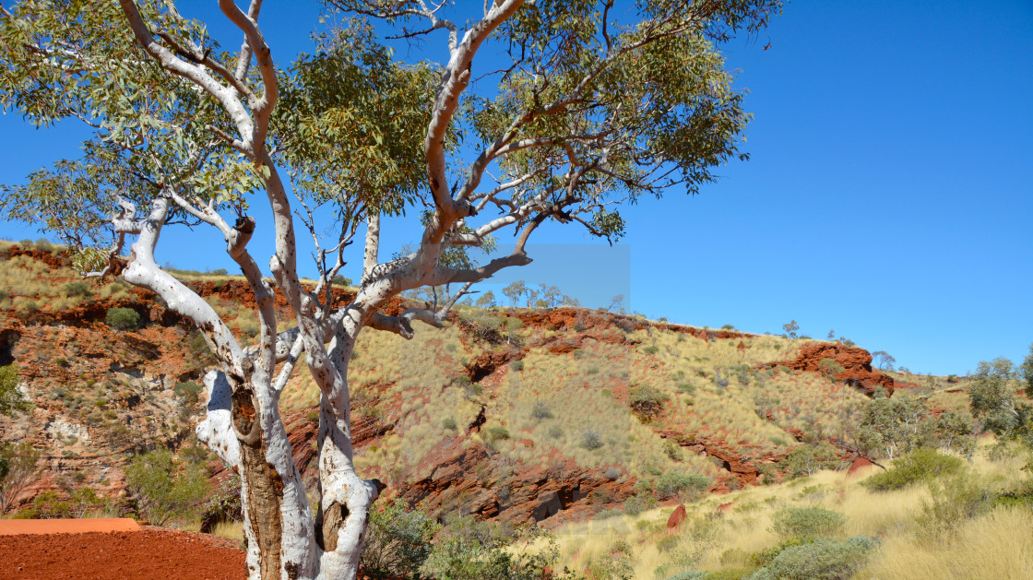
Questions?

Slide 11
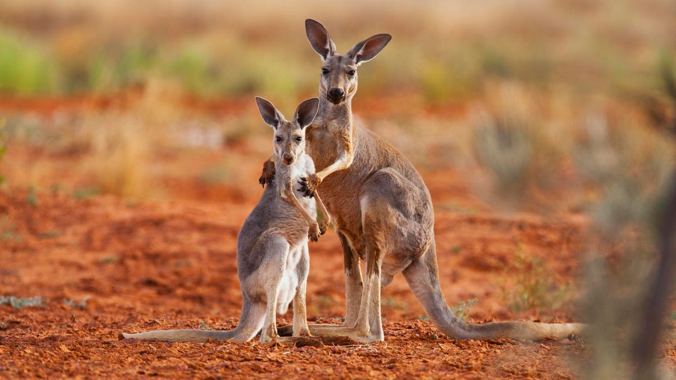
Thank you for your time.

Slide 12
Reference List (WiP)

Slide 13
Gesture Plan (WiP)

